Slide 1
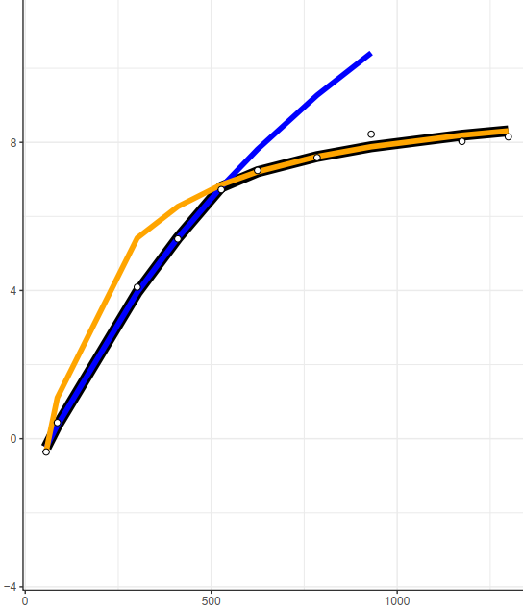
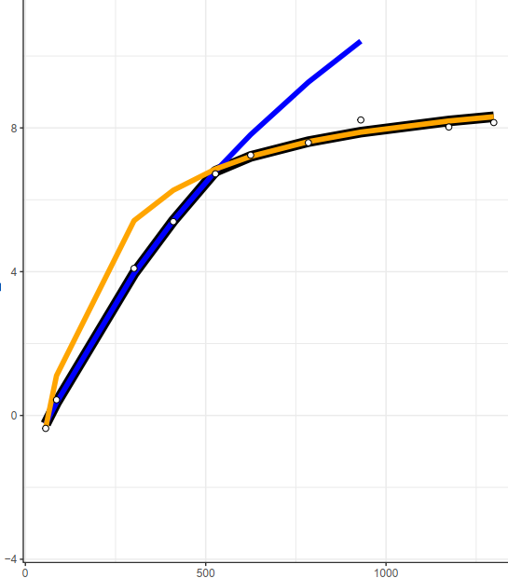
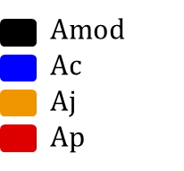
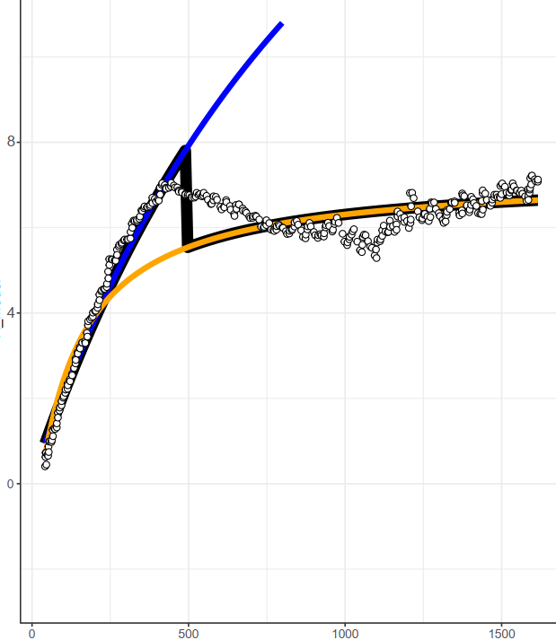
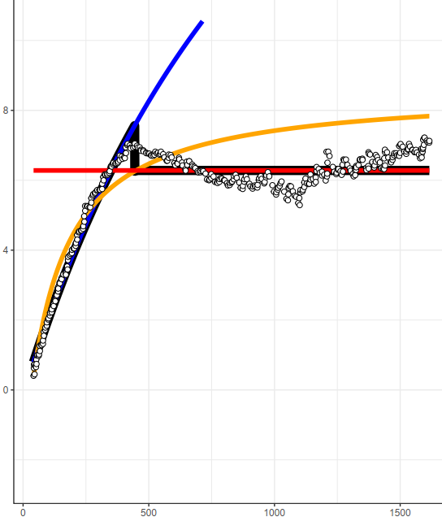


Couratari stellata, Leaf 1
Without TPU
With TPU
Steady-State
Modeled A
DAT
Modeled A
$$C_{i}$$
$$C_{i}$$

Slide 2
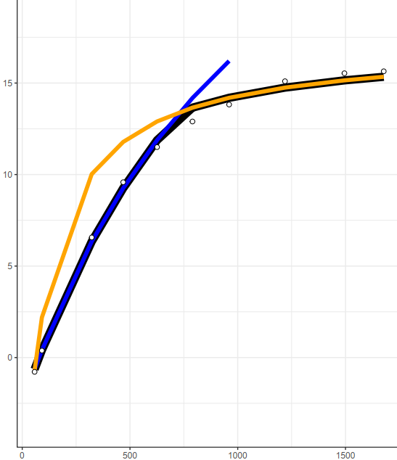

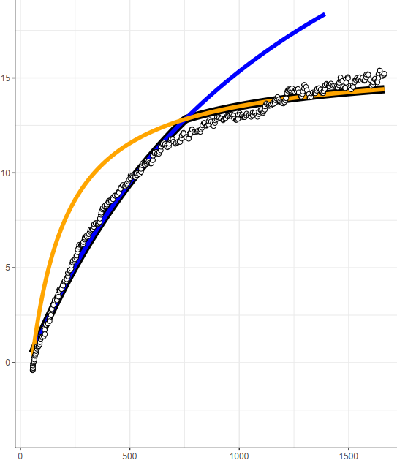
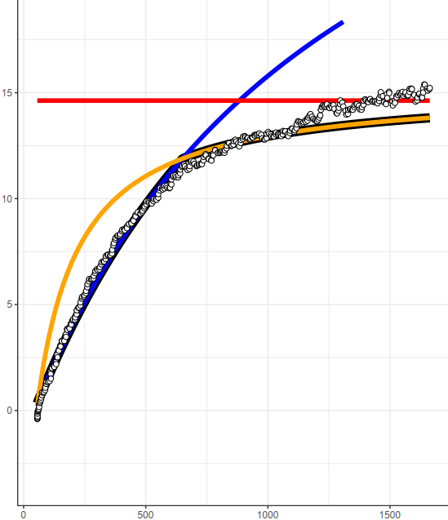
Abarema mataybifolia-1, Leaf 1
Without TPU
With TPU
Steady-State
Modeled A
DAT
Modeled A
$$C_{i}$$
$$C_{i}$$

Slide 3
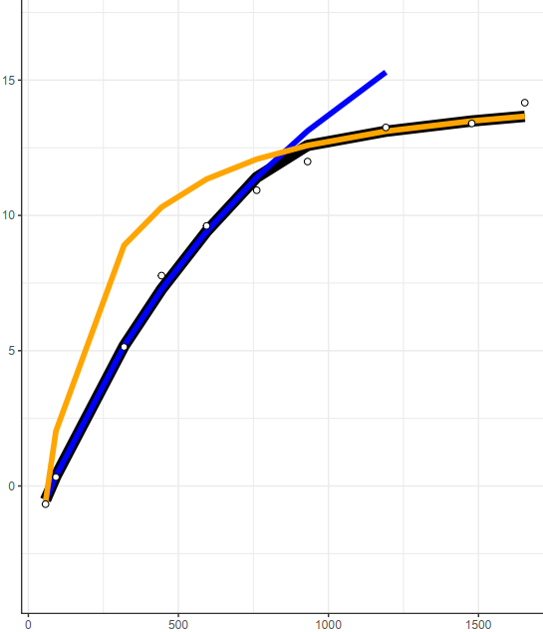

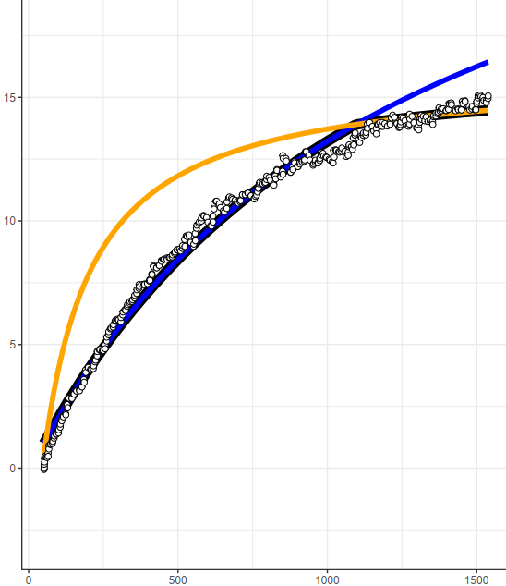
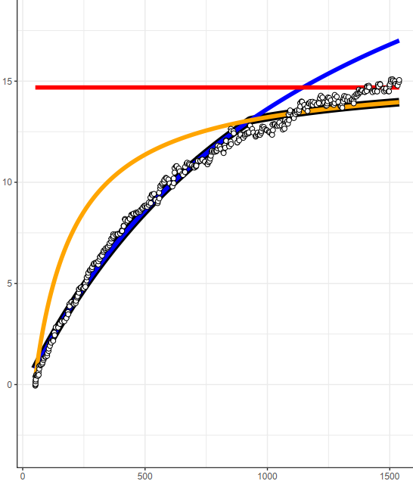
Abarema mataybifolia-1, Leaf 2
Without TPU
With TPU
Steady-State
Modeled A
DAT
Modeled A
$$C_{i}$$
$$C_{i}$$

Slide 4
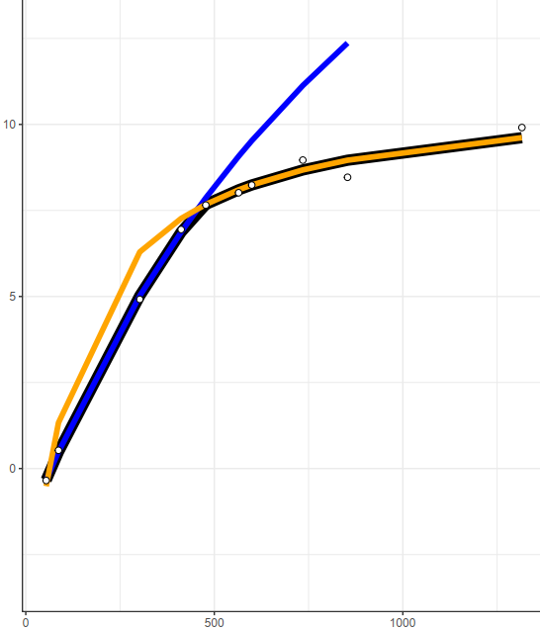
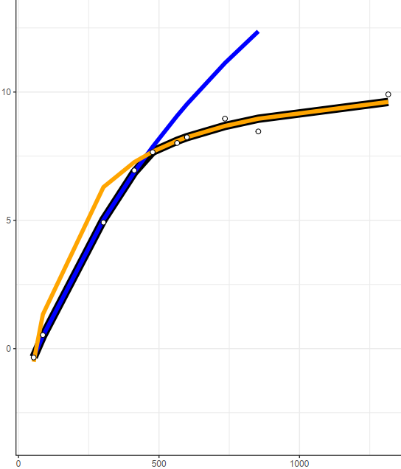
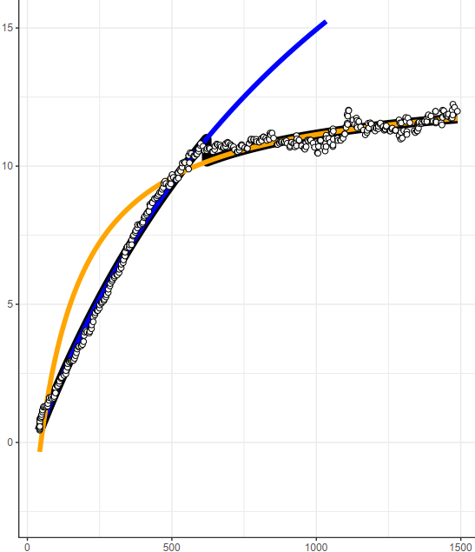
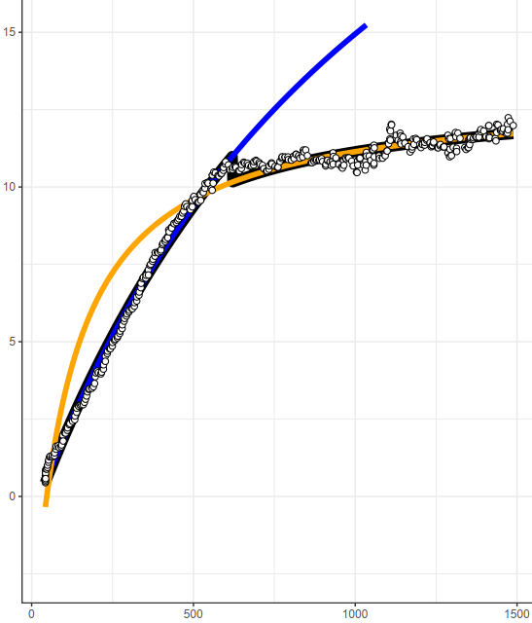
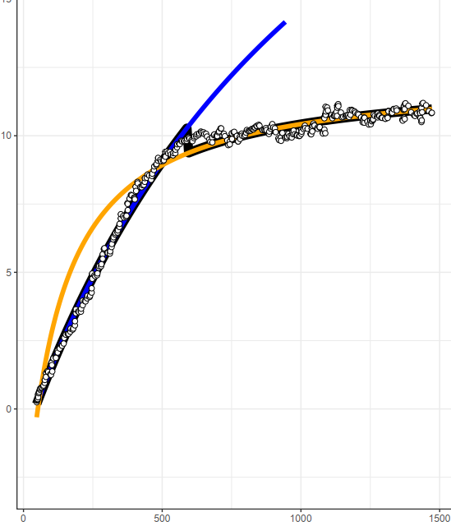



Protium apiculatum, Leaf 1
Without TPU
With TPU
Steady-State
Modeled A
Modeled A
DAT
Modeled A
$$C_{i}$$
$$C_{i}$$

Slide 5
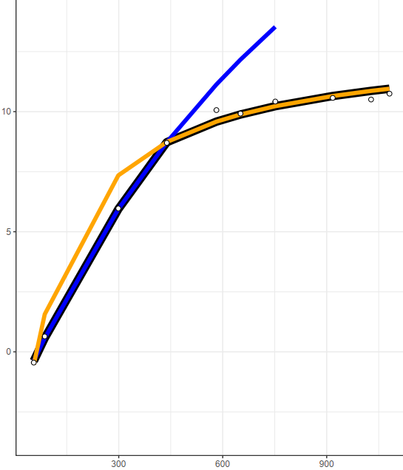
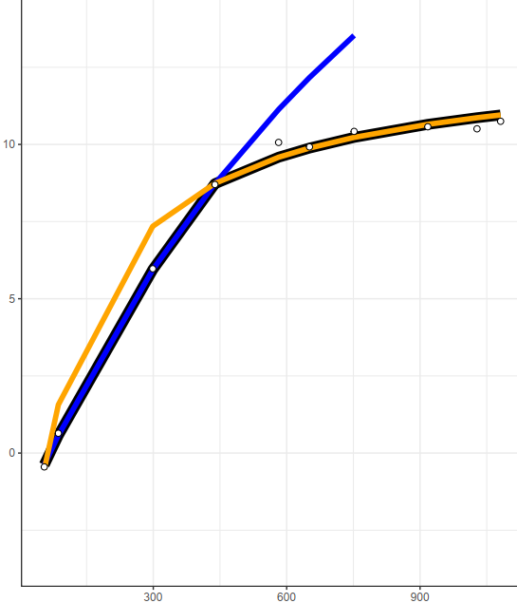
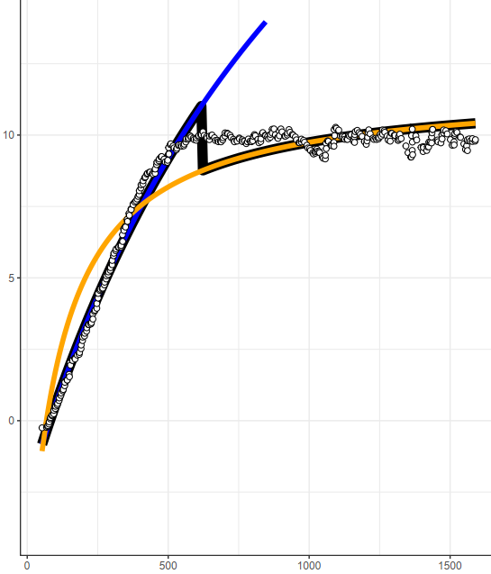
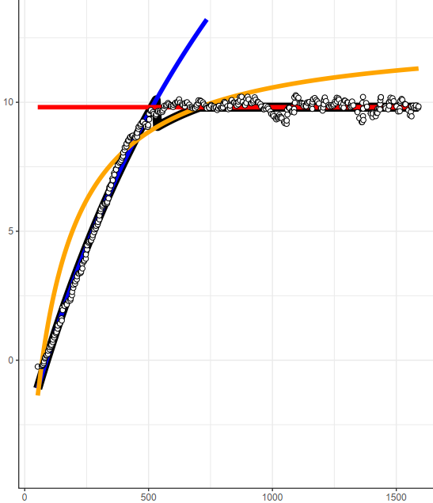
Protium apiculatum, Leaf 2
Without TPU
With TPU
Steady-State
Modeled A
DAT
Modeled A
$$C_{i}$$
$$C_{i}$$

Slide 6
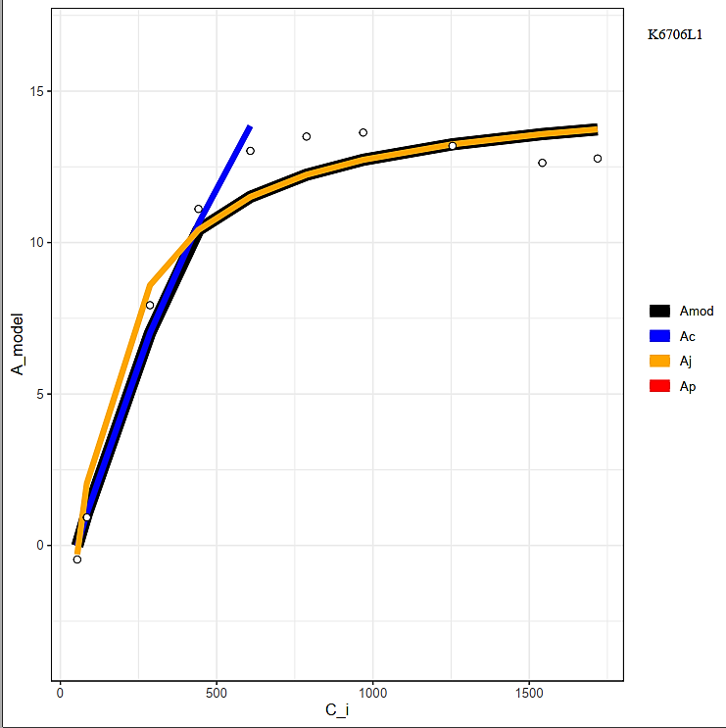
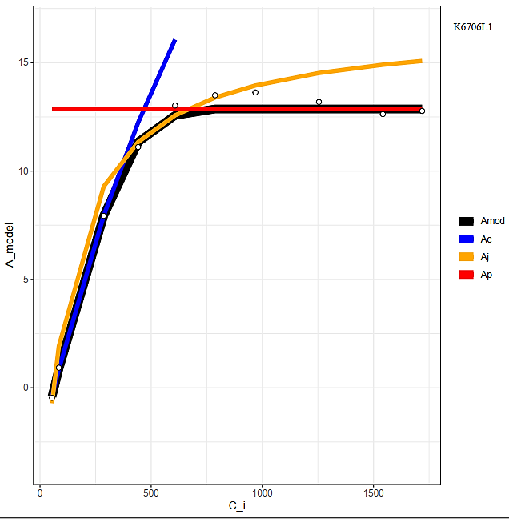
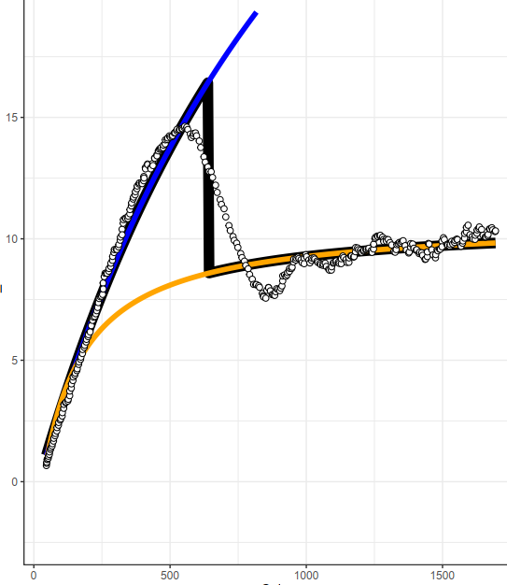
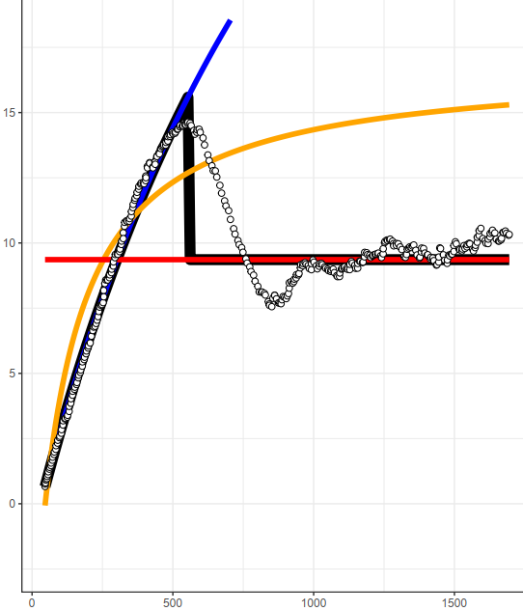
Eschweilera sp. trufle1, Leaf 1
Without TPU
With TPU
Steady-State
Modeled A
DAT
Modeled A
$$C_{i}$$
$$C_{i}$$

Slide 7
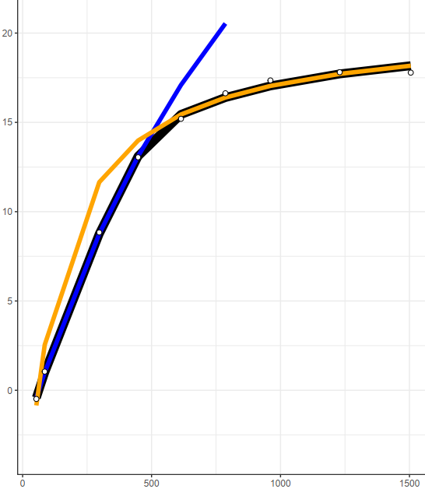
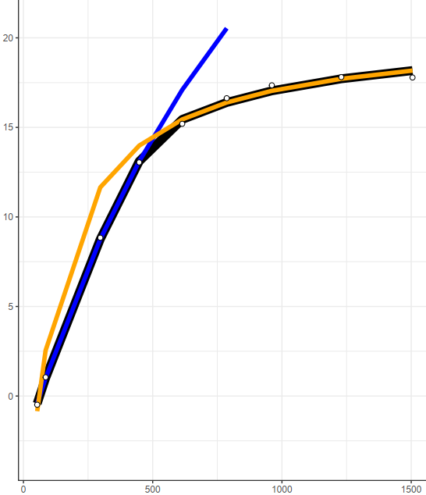
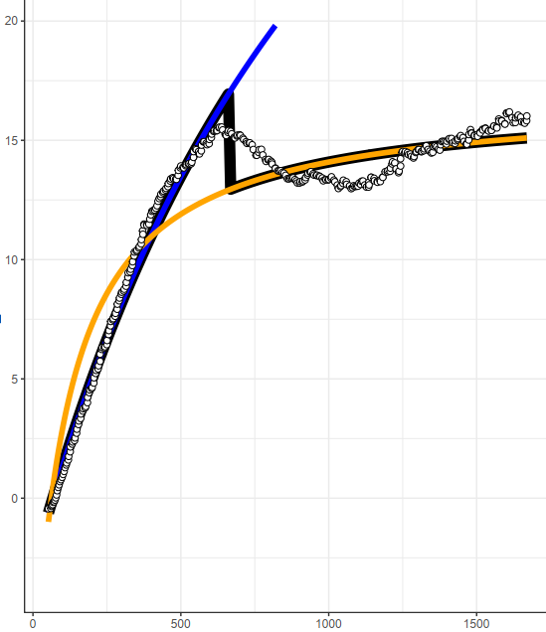
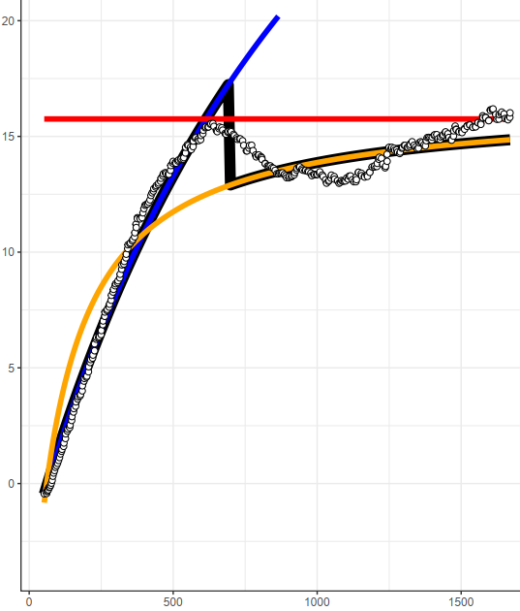
Eschweilera sp. trufle1, Leaf 2
Without TPU
With TPU
Steady-State
Modeled A
DAT
Modeled A
$$C_{i}$$
$$C_{i}$$

Slide 8
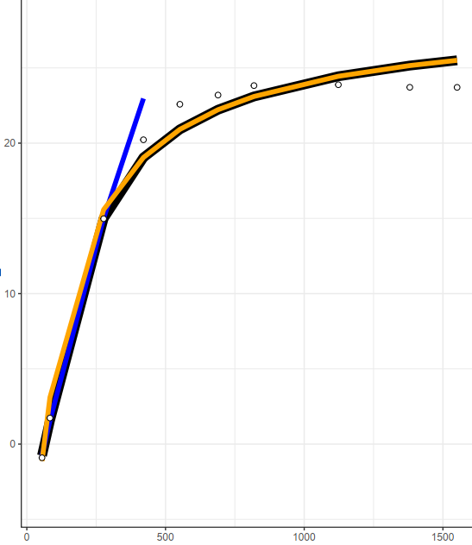
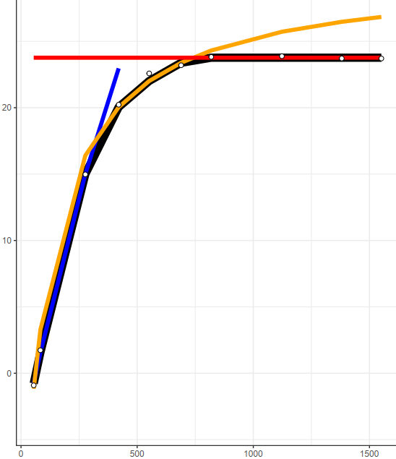
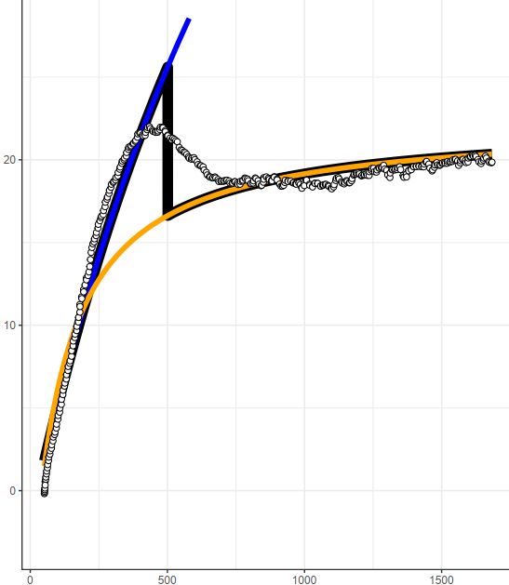
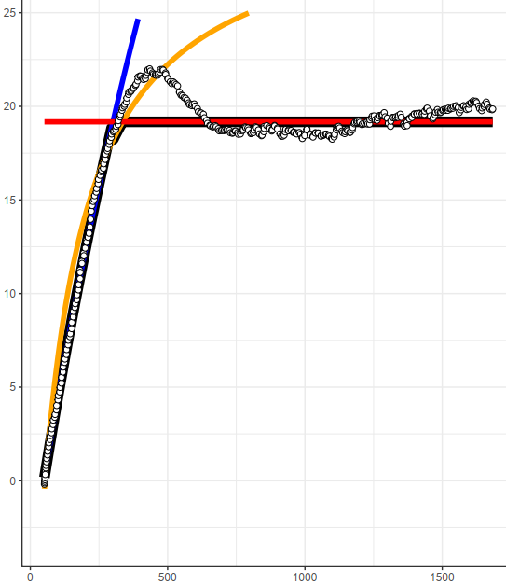
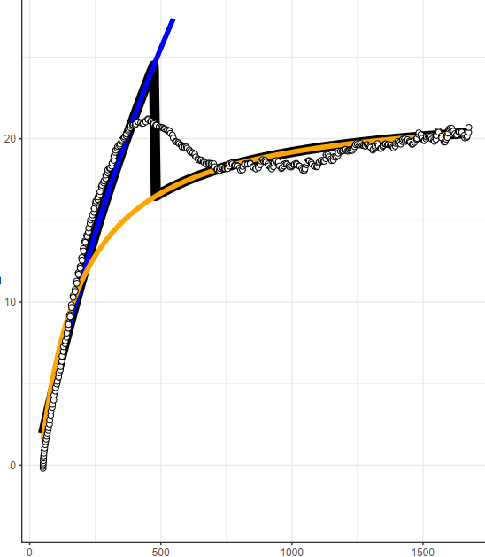
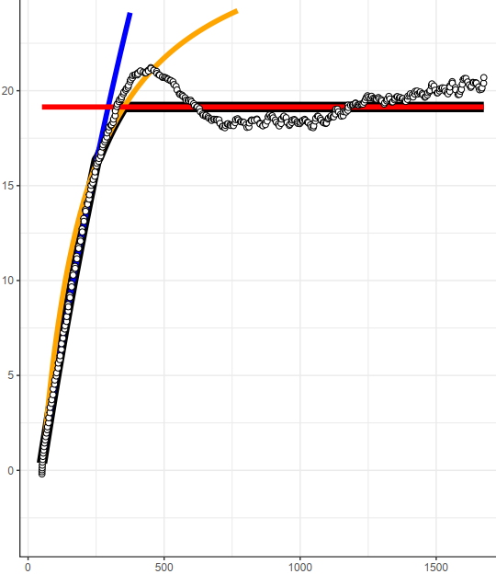


Tachigali chrysophylla, Leaf 1
Without TPU
With TPU
Steady-State
Modeled A
Modeled A
DAT
Modeled A
$$C_{i}$$
$$C_{i}$$

Slide 9
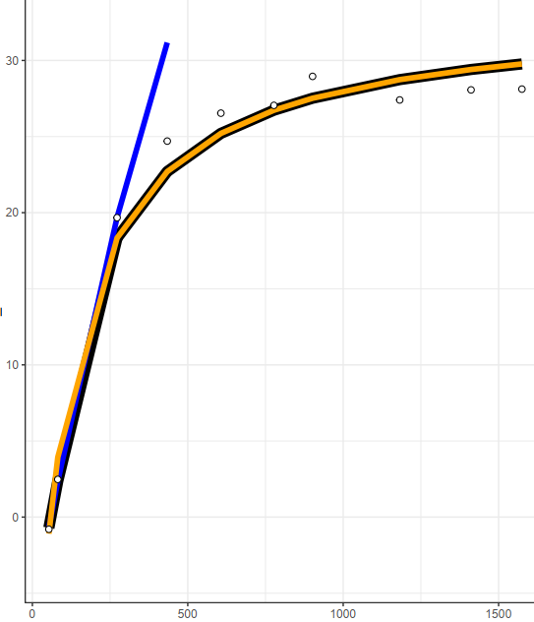
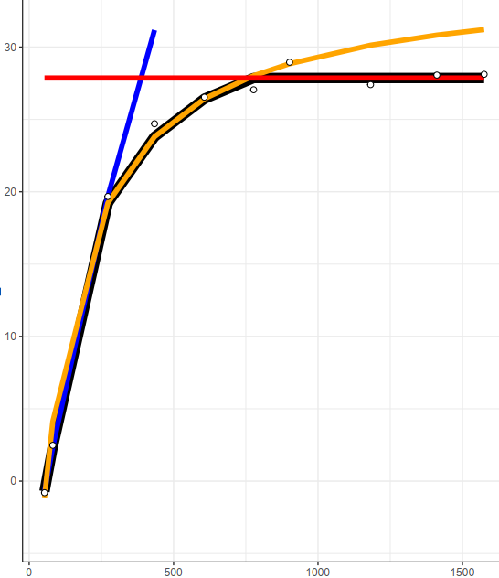
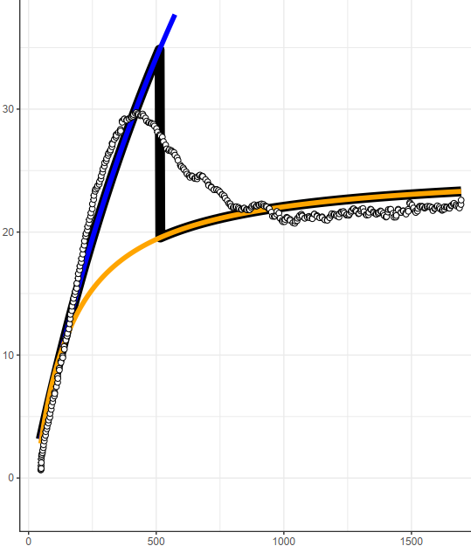
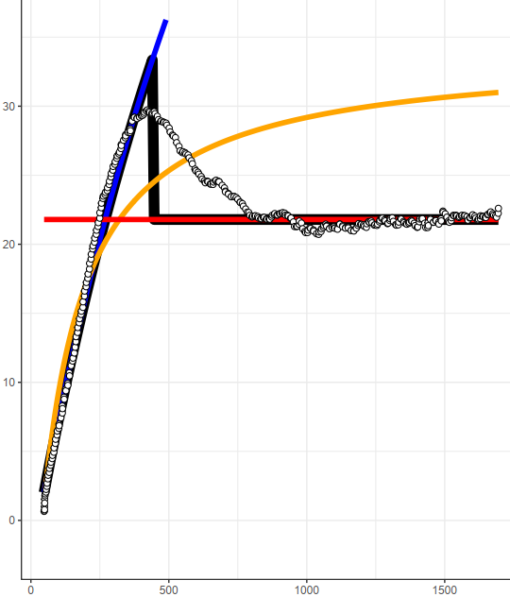
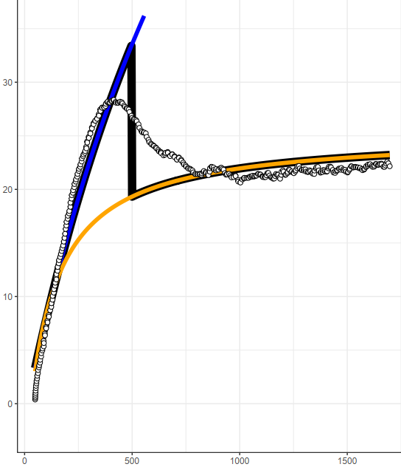
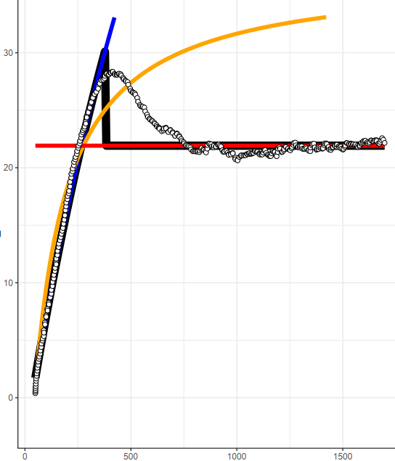
Tachigali chrysophylla, Leaf 2
Without TPU
With TPU
Steady-State
Modeled A
Modeled A
DAT
Modeled A
$$C_{i}$$
$$C_{i}$$

Slide 10
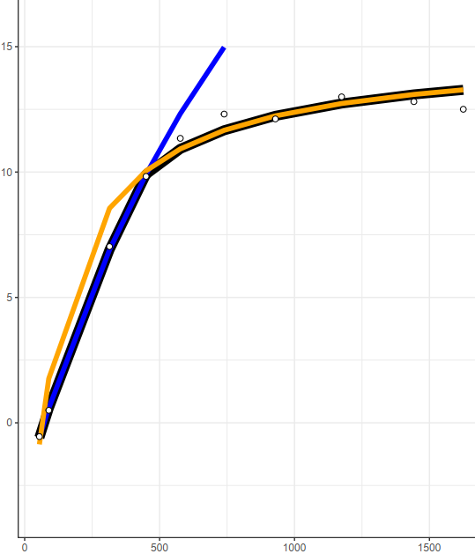

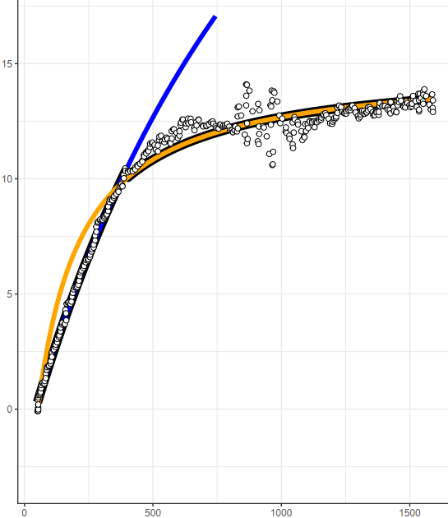
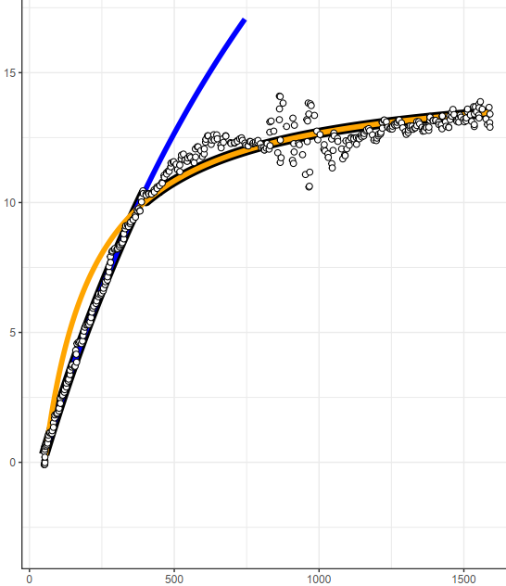
Chimarrhis turbinate, Leaf 1
Without TPU
With TPU
Steady-State
Modeled A
DAT
Modeled A
$$C_{i}$$
$$C_{i}$$

Slide 11
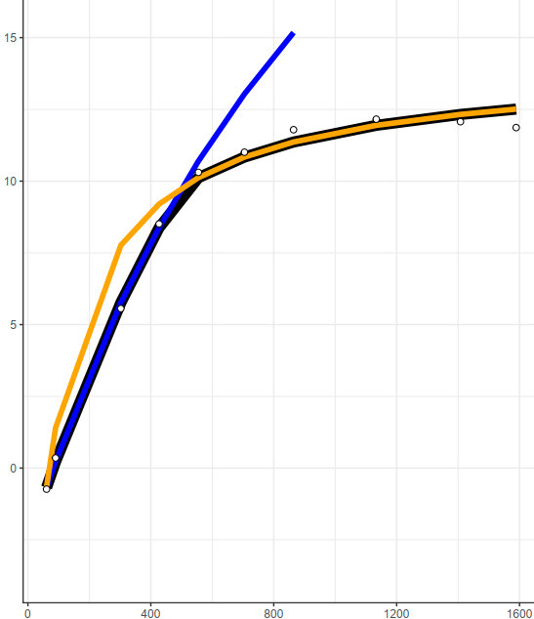
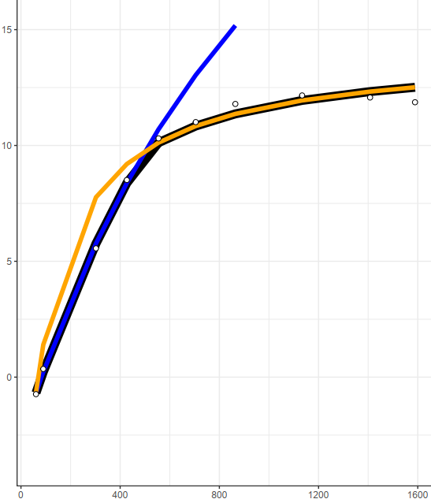
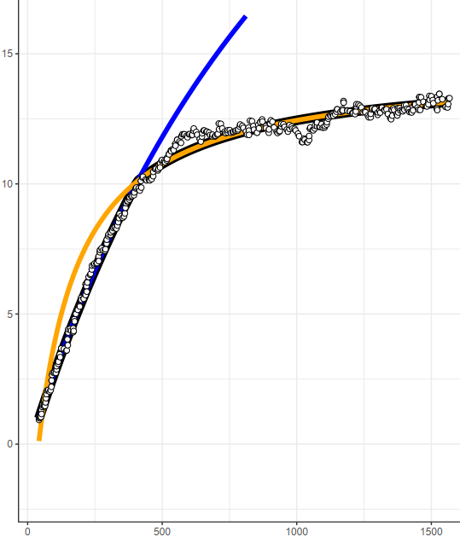

Chimarrhis turbinate, Leaf 2
Without TPU
With TPU
Steady-State
Modeled A
DAT
Modeled A
$$C_{i}$$
$$C_{i}$$

Slide 12
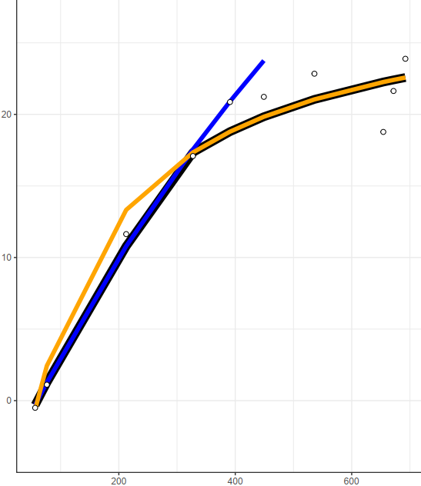
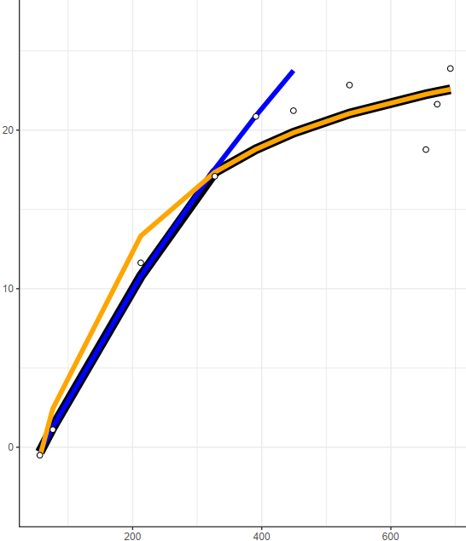
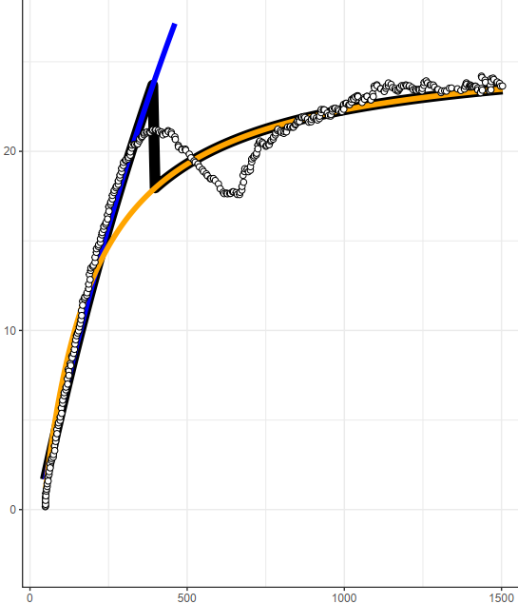

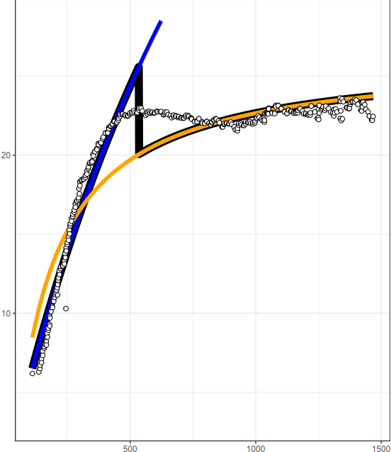

Manilkara elata, Leaf 2
Without TPU
With TPU
Steady-State
Modeled A
Modeled A
DAT
Modeled A
$$C_{i}$$
$$C_{i}$$

Slide 13




Manilkara elata, Leaf 6
Without TPU
With TPU
Steady-State
Modeled A
DAT
Modeled A
$$C_{i}$$
$$C_{i}$$

Slide 14




Manilkara elata, Leaf 8
Without TPU
With TPU
Steady-State
Modeled A
DAT
Modeled A
$$C_{i}$$
$$C_{i}$$

Slide 15




Vismia cayennensis, Leaf 1
Without TPU
With TPU
Steady-State
Modeled A
DAT
Modeled A
$$C_{i}$$
$$C_{i}$$

Slide 16




Vismia cayennensis, Leaf 2
Without TPU
With TPU
Steady-State
Modeled A
DAT
Modeled A
$$C_{i}$$
$$C_{i}$$

Slide 17




Vismia cayennensis, Leaf 3
Without TPU
With TPU
Steady-State
Modeled A
DAT
Modeled A
$$C_{i}$$
$$C_{i}$$

Slide 18




Anaxagorea dolichocarpa, Leaf 1
Without TPU
With TPU
Steady-State
Modeled A
DAT
Modeled A
$$C_{i}$$
$$C_{i}$$

Slide 19




Anaxagorea dolichocarpa, Leaf 2
Without TPU
With TPU
Steady-State
Modeled A
DAT
Modeled A
$$C_{i}$$
$$C_{i}$$

Slide 20






Coussarea paniculata, Leaf 1
Without TPU
With TPU
Steady-State
Modeled A
Modeled A
DAT
Modeled A
$$C_{i}$$
$$C_{i}$$

Slide 21




Coussarea paniculata, Leaf 2
Without TPU
With TPU
Steady-State
Modeled A
DAT
Modeled A
$$C_{i}$$
$$C_{i}$$

Slide 22




Miconia egensis, Leaf 1
Without TPU
With TPU
Steady-State
Modeled A
DAT
Modeled A
$$C_{i}$$
$$C_{i}$$

Slide 23




Miconia egensis, Leaf 2
Without TPU
With TPU
Steady-State
Modeled A
DAT
Modeled A
$$C_{i}$$
$$C_{i}$$

Slide 24




Aparisthmium cordatum, Leaf 1
Without TPU
With TPU
Steady-State
Modeled A
DAT
Modeled A
$$C_{i}$$
$$C_{i}$$

Slide 25




Aparisthmium cordatum, Leaf 2
Without TPU
With TPU
Steady-State
Modeled A
DAT
Modeled A
$$C_{i}$$
$$C_{i}$$

Slide 26




Abarema mataybifolia-2, Leaf 1
Without TPU
With TPU
Steady-State
Modeled A
DAT
Modeled A
$$C_{i}$$
$$C_{i}$$

Slide 27




Abarema mataybifolia-2, Leaf 2
Without TPU
With TPU
Steady-State
Modeled A
DAT
Modeled A
$$C_{i}$$
$$C_{i}$$

